Slide 1

End-Sem Review
API METADATA BASED DYNAMIC APPLICATION GENERATION FOR BUSINESS INSIGHTS
Navya Khurana

Slide 2


Agenda
Problem Statement
Solution & Architecture
Summarisation Chain techniques
  Stuff
  Map Reduced
  Refine
Custom Model Creation & consuming cap-llm
Consuming custom model in summarization chain
Demo: BO Summarisation
Roadmap / Future Enhancements

Slide 3

<heading>
Problem Statement
Text
Example-1
Example-2
All Equipment undergoes extensive maintenance, making it crucial to have immediate access to the maintenance history readily available for prompt action.
Keeping a track of the overall history of maintenance is tiresome as that can be a lot of data, confusing the user as to what action to take next.
Different people handle different purchase orders and make different business decisions based on this data
Once there is a lot of this data, the different personas might be confusing.
A concise map of the data telling the personas exactly what they want would enable them to take action
In general, any Business Object one uses from SAP has some latent data that is very important to business decisions.
But because this data is latent, a lot of times this data’s true business value is not extracted because these fields contain a lot of data.
Something that could make sense of all of the loads of data could help in making better business decisions
Plant Maintenance
Purchase Order
Business Object

Slide 4

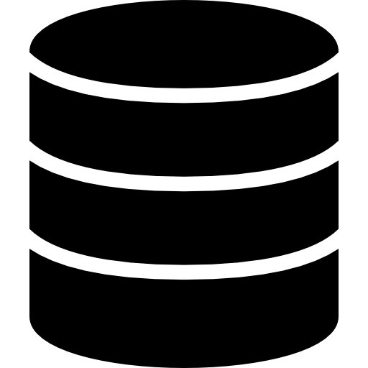










Solution
BO2
BOn
Find API
BO1
SAP Build Work zone
Domain
Service
UI App
API Hub
SAP Help Documentation
BO(n) * Computing Resource
Integration
More Development Time
Repeat Maintenance
Find API
Config File JSON
(Business Object 1,…n)
SAP Build Work zone
API Hub
SAP Help Documentation
Easier Maintenance
Shared Computing Resources
One Deployment for all

Slide 5

Config File (JSON)
(Business Object 1..n)
Find API
Domain
Service
UI App
API Hub
SAP Build Work zone
SAP Help
Documentation
Integration
Identify the API for the required Business Object to configure it’s detail in the config file in order to create the application.
BTP Services
Summarization (Langchain)
Stuff | Map-Reduce | Refine
Business Systems
Once the deployment is successful, a group needs to be created and the app's visibility set to view the app tiles on the UI.
BO Summarization application encompasses the domain, service, and UI components dynamically generated from a single config file maintained by the end user
Easier Maintenance
Shared Computing Resources
One Deployment for all

Slide 6
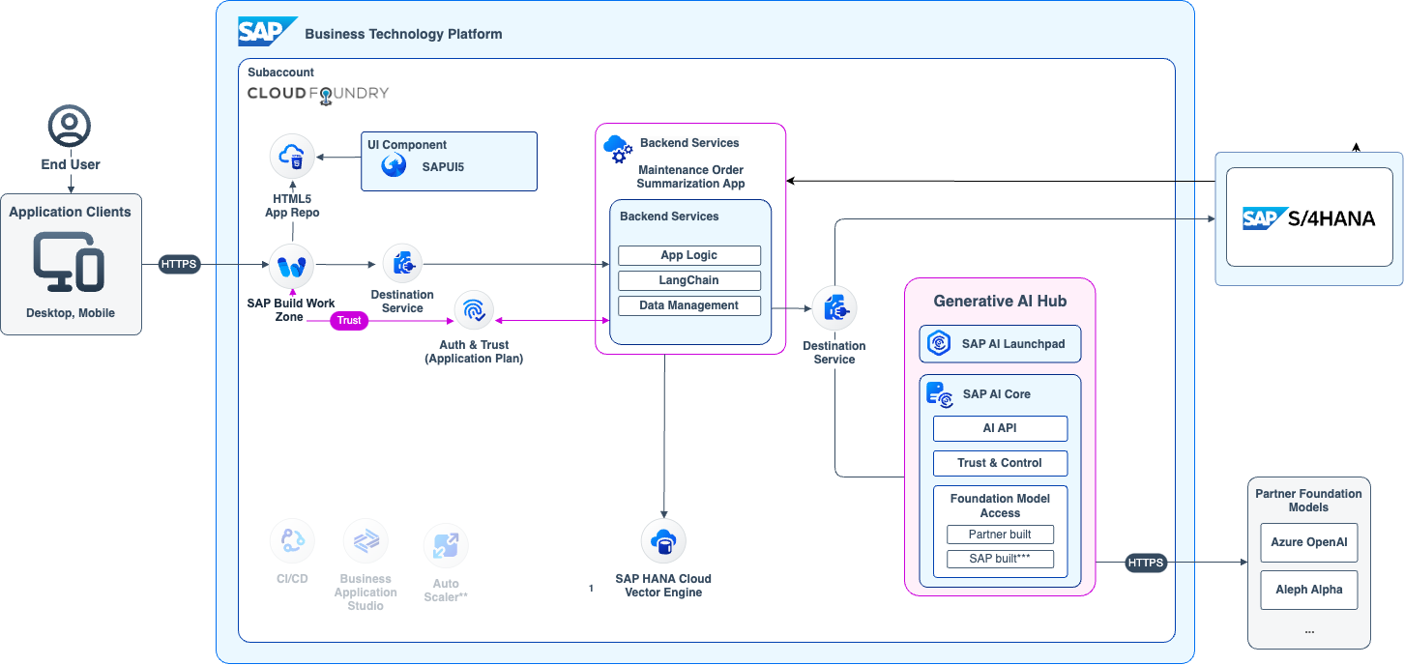
Architecture
Cloud Application Programming model ensures efficiency, scalability & security
SAP HANA Cloud Vector Engine stores embeddings & has similarity search
SAP GenAI Hub provides safe and reliable access to catalogue of LLMs
Multi tenancy allows to run multi-app orchestration wo replication of resources

Slide 7
Summarization Chain & its Techniques
Stuff
Stuff
The Stuff method handles list of documents, insert them all into a prompt, and pass that prompt to an LLM for summarization.
Map-Reduce
Map-Reduce
The Map-Reduce method divides the document into chunks and each chunk is summarized (map step). Then, these summaries are combined into a final summary (reduce step).
Refine
Refine
The chain updates a rolling summary by iterating over the documents in a sequence. In each iteration, the current document and the previously generated summary are passed as prompt for summarization.

Slide 8





Summarization Chain & its Techniques
Stuff Chain is the simplest way to start summarizing
Stuff
Straightforward Approach
A simple way to summarize
Stuff is a straightforward approach where we include all the data given in the prompt to be passed as context to the language model.
Final Summary
Simple Usage
………………………………….. …………………………………..
…………………………………..
…………………………………..
…………………………………..
…………………………………..
…………………………………..
…………………………………..
…………………………………..
…………………………………..
…………………………………..
You only need to make a single call to the LLM as the LLM has access to all the data at once.
Prompt
with inserted content
{Document}
Chat Model
GenAI Hub
Not good for large documents
Most LLMs have a maximum context length, and for large docs or many docs, this approach becomes impractical.
Documents
Map-Reduce
Refine

Slide 9
Summarization Chain & its Techniques
Stuff
Stuff
The Stuff method handles list of documents, insert them all into a prompt, and pass that prompt to an LLM for summarization.
Map-Reduce
Map-Reduce
The Map-Reduce method divides the document into chunks and each chunk is summarized (map step). Then, these summaries are combined into a final summary (reduce step).
Refine
Refine
The chain updates a rolling summary by iterating over the documents in a sequence. In each iteration, the current document and the previously generated summary are passed as prompt for summarization.

Slide 10
Summarization Chain & its Techniques
Map-Reduce is the pragmatic solution to Summarization
Stuff
2 step process
Map-Reduce
This is a 2 step process that simplifies the task of summarizing a document, namely map and reduce.
Chunk-1
Prompt
{chunk-1}
Chat Model
Summary
GenAI Hub
Chunk-2
Prompt
{chunk-2}
Chat Model
Summary
Map Step
GenAI Hub
Document is divided into small, manageable chunks. Each chunk is then individually summarized using LLMChain.
Splitter
Splits content into smaller chunks
Chunk-3
Prompt
{chunk-3}
Chat Model
Summary
GenAI Hub
Chunk-n
Prompt
{chunk-n}
Summary
Reduce Step
Chat Model
Documents
GenAI Hub
Second step, where we aim to combine these individual summaries into one cohesive final summary.
Map Chain
Chunk Summaries
Refine

Slide 11
Summarization Chain & its Techniques
Map-Reduce is the pragmatic solution to Summarization
Stuff
Protection from Token Limit
Map-Reduce
Attempting to merge all the chunk summaries at once might still run into token limit constraints. To address this challenge, the "Reduce Documents Chain" employs a smart iterative approach.
Summary
Stuff Documents
Chain
Summary
Final Summary
Summary
………………………………….. …………………………………..
…………………………………..
…………………………………..
…………………………………..
…………………………………..
…………………………………..
…………………………………..
…………………………………..
…………………………………..
…………………………………..
Pros
Stuff Documents Chain
Efficiently divides and summarizes large documents. It also overcomes token limit constraints by iteratively reducing chunks
Summary
Summary
Cons
Stuff Documents
Chain
It involves multiple iterations which may impact processing time.
Summary
Summary Chunks
Reduce Documents Chain
Refine

Slide 12
Summarization Chain & its Techniques
Stuff
Stuff
The Stuff method handles list of documents, insert them all into a prompt, and pass that prompt to an LLM for summarization.
Map-Reduce
Map-Reduce
The Map-Reduce method divides the document into chunks and each chunk is summarized (map step). Then, these summaries are combined into a final summary (reduce step).
Refine
Refine
The chain updates a rolling summary by iterating over the documents in a sequence. In each iteration, the current document and the previously generated summary are passed as prompt for summarization.

Slide 13
Summarization Chain & its Techniques
Refine is the nuanced approach to Summarization
Iterative Approach
Stuff
Begins with an initial prompt on the first chunk of data, which generates an initial output. The 'refine documents chain' constructs a response by iteratively cycling through the input documents and progressively updating its answer
Map-Reduce
Refine
Prompt
Chunk-1
Chat Model
Summary
Chunk-1
GenAI Hub
Increases Relevance
Prompt
Has the potential to incorporate more relevant context, potentially resulting in less loss of information compared to Map-Reduce
Chunk-2
Chat Model
Summary
Splitter
Chunk-2
Summary
GenAI Hub
Splits content into smaller chunks
Prompt
Can lead to slow processing
Chunk-3
Chat Model
Summary
Chunk-3
Summary
GenAI Hub
Good things take time, and so does refine. It involves a larger number of LLM calls, that aren’t independent and can’t be parallelized like Map-Reduce
Prompt
Final Summary
Chunk-4
Chat Model
Documents
Chunk-4
Summary
GenAI Hub

Slide 14
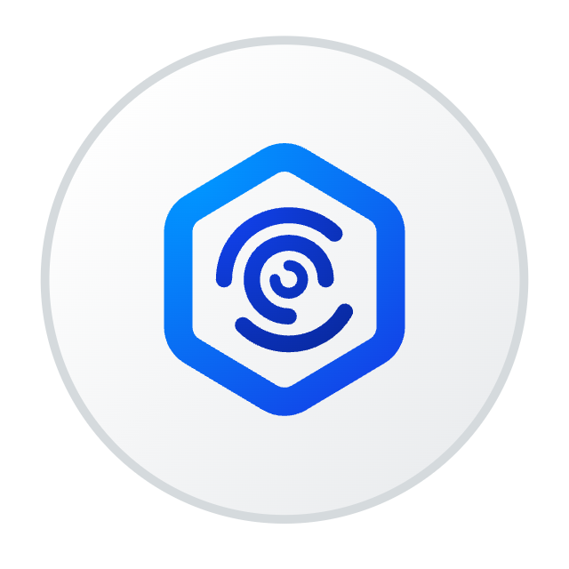

Consuming Custom Chat Model
SAP Business Technology Platform
Langchain
Map-Reduce
Generative AI Hub
Summarization Chain
Refine
SAP AI Launchpad
Stuff
Map Reduce
Refine
Chat Models
SAP AI Core
Custom Chat Model
Llama
Open AI
Anthropic
AI API
Trust & Control
Partner Foundations Model
cap-llm-plugin
(Consuming Library)
Foundation Model
Access
Azure OpenAI
Partner built
Open Sourced
Aleph Alpha
. . . .

Slide 15
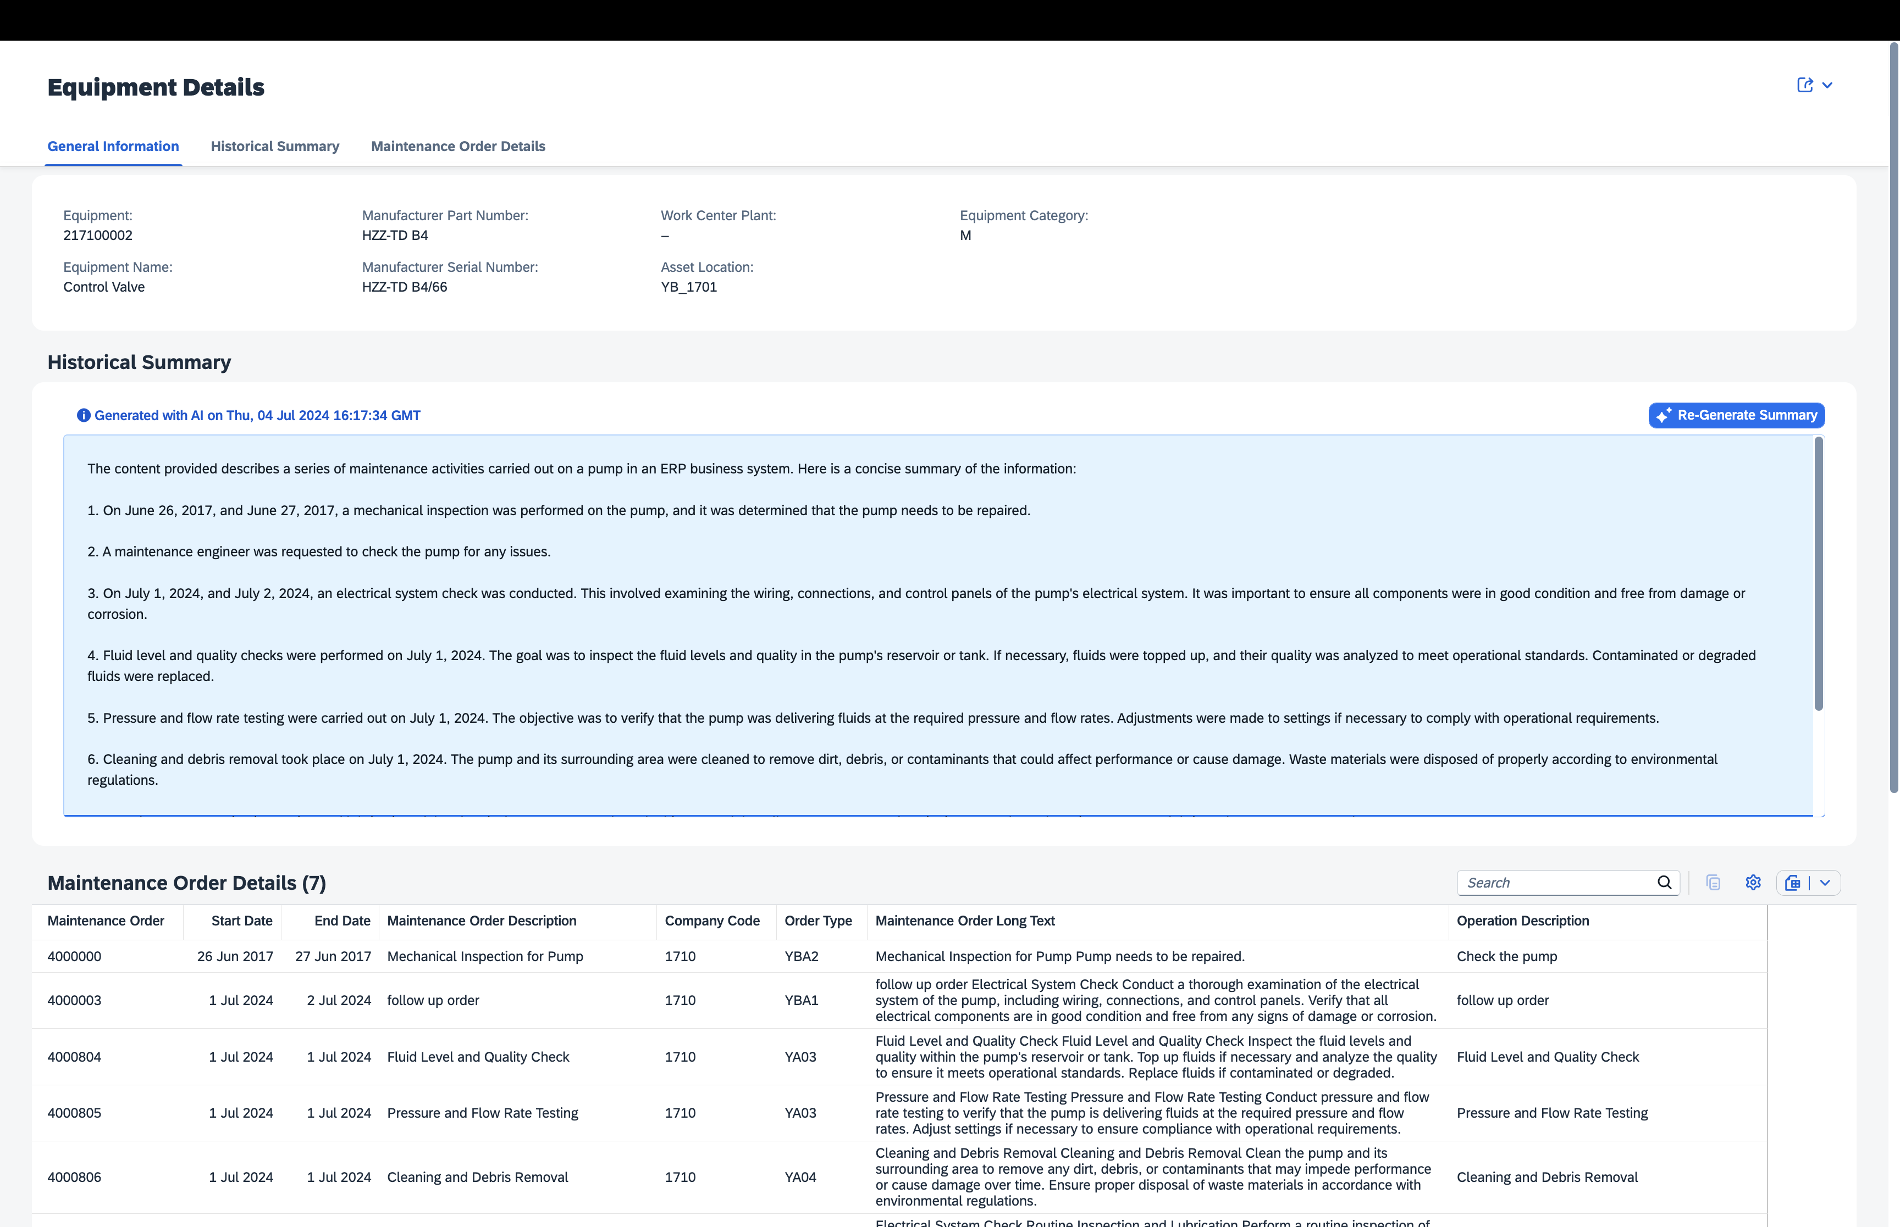
DEMO
Let’s Get Started.
Maintenance Order Summarization (Based on Equipment)
Notes:
Emission Factor Mapping with AI SAP Sustainability Footprint Management Base AI Planned for Q2/24
Reduce time and increase accuracy of carbon footprint calculations by providing automated, intelligent emission factor mapping suggestions.
To calculate product carbon footprints, users need to map hundreds or potentially thousands or millions of internal materials and products to external lifecycle assessment emission factors that are obtained through in-house sources or external databases.
This is largely a manual task requiring significant human resources, which are prone to manual error, and lifecycle assessment (LCA) expert knowledge.
SAP Sustainability Footprint Management provides automated, intelligent emission factor mapping suggestions, based on product name, product group, location, and commodity code.
This will decrease the time necessary to calculate full product carbon and corporate footprints and will increase the overall accuracy while allowing non LCA-experts to map emission factors with more confidence.
For example: Imagine you are buying raw materials and parts for your production process. To calculate your own product footprint, you need all the CO2e values of your purchased parts. If the vendor is not able to deliver you CO2e values for his products, external databases are able to give you industry standard average numbers. AI helps you connect your purchased materials with these databases and provide the information to your database in real time.

Slide 16
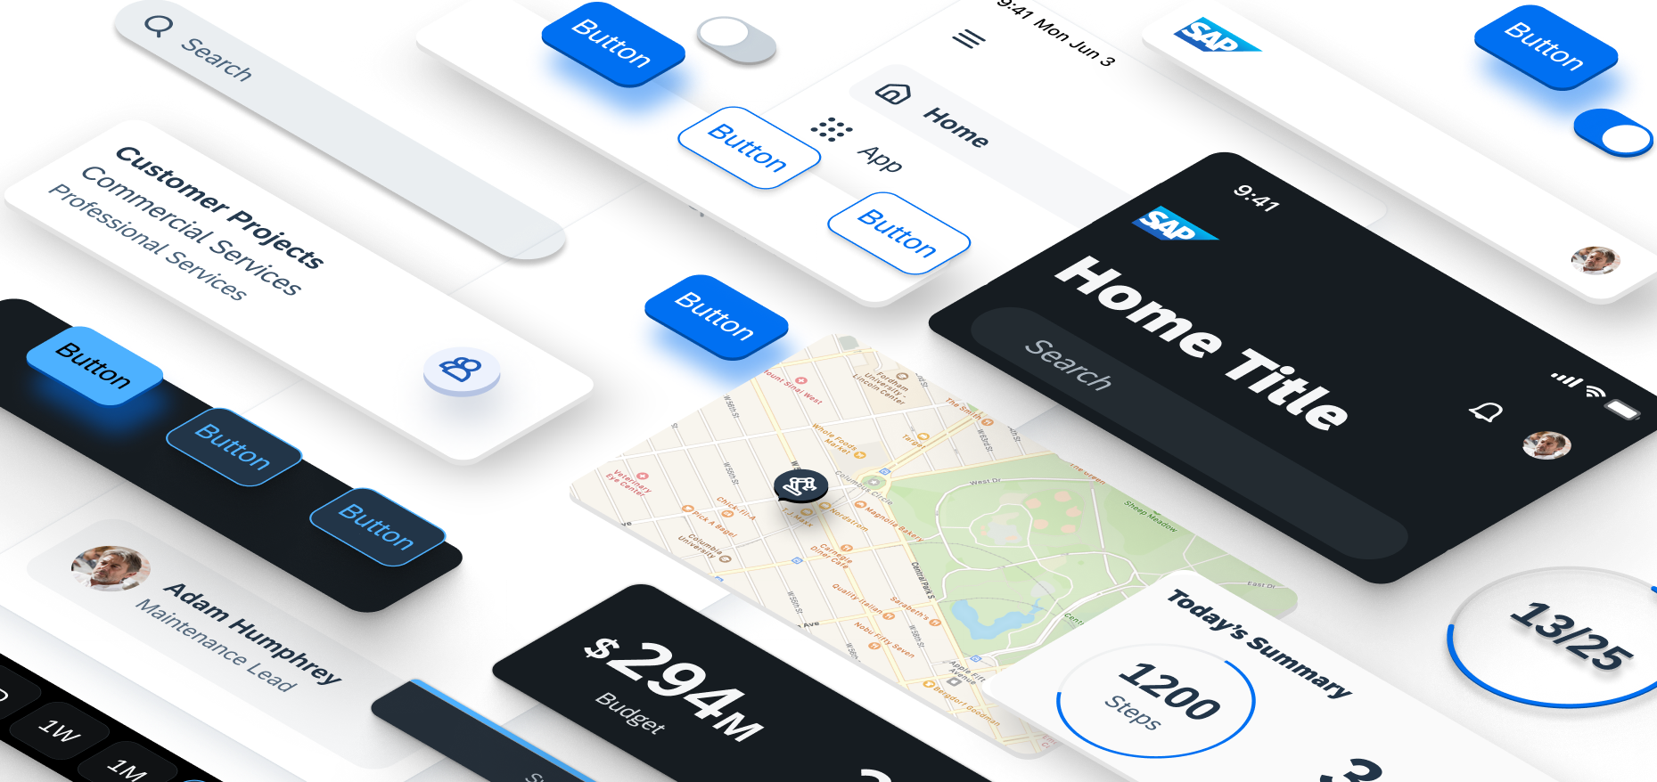



Roadmap / Future Enhancements
What we have planned for Phase 2
Simplify Business Object Config file creation with selection of entity and its fields for users via a UI.
Include human feedback loop to figure out best technique of summarization that provides better results.
Include support for Business Objects using REST API and also re-engineer the set up of application for Kyma.
Notes:
Infuse Business AI across the SAP product portfolio
We leverage our data treasure to embed
relevant, reliable and responsible Business AI into our solutions. This revolutionizes how our customers interact with SAP business systems – e.g. through Joule. With a trusted AI foundation on BTP, we empower customers and partners to consume and build context-aware, intelligent applications.
Build and run the leading suite
for every business with Cloud ERP & BTP at the core complemented by HXM, ISBN & CX
We differentiate by enabling consistent e2e processes through an integrated, intelligent suite of applications driven by cross priorities and suite qualities as well as proactive customer support. We address new customers with Cloud ERP and empower existing ones to add capabilities of our LoB and industry solution, all powered by BTP – the extension, integration, data and AI platform for our entire ecosystem.
Accelerate business-driven innovation and scale our new growth areas
We accelerate business-driven innovations that create real-life customer value focused on rethinking our key innovations fields: the future of business processes, business collaboration and data-driven decision-making. We scale our dedicated New Growth Areas (Signavio, Business Network, Taulia, Sustainability & Business AI) to accelerate in these fields and future-proof our suite.

Slide 17
Connect.
Connect.
Let’s Get Started.
Automate.
Automate.
Innovate.
Innovate.

Slide 18
Thank you
Navya Khurana
© 2023 SAP SE or an SAP affiliate company. All rights reserved. See Legal Notice on www.sap.com/legal-notice for use terms, disclaimers, disclosures, or restrictions related to this material.

